Slide 1

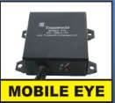
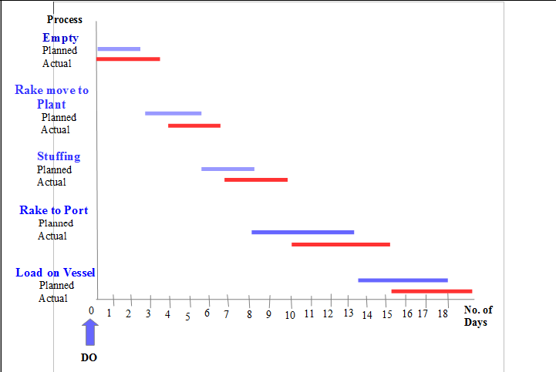
Visibility Report
Transworld
ICD to Mahan Plant to JNPT Port
Rake-#18

Slide 2
Visibility Report
Transworld

